Slide 1
NEW Ways of working with GTT

Slide 2
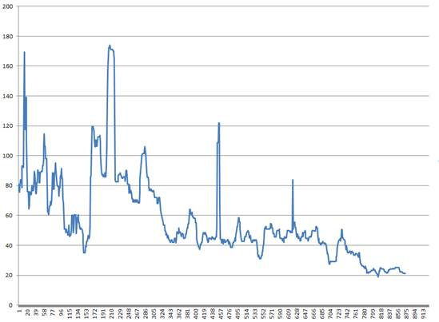
GTT_LSV quality improvements
Initiatives 2014/2015:
Team Shadow
Tiger Team
TSAR rotations to Shadow
Shadow rotation to TR team
GTT_LSV TR sprints
30
GTT_LSV FAULTS per regression 10-point median filter Aug 2014 – Aug 2015
Targets:
Remove umbrella TR at 35 faults/build (10 point median)
Remove team Shadow at 30 faults/build (10 point median)
Establish long term quality plan
√
√
√

Slide 3
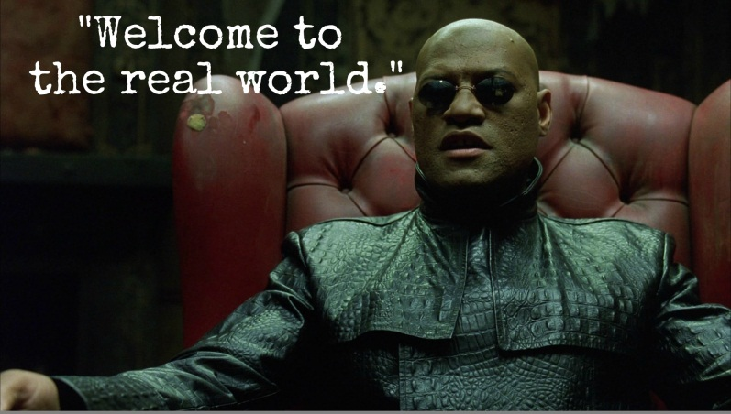
GTT_LSV Long term plan
No umbrella tr
TR map GTT_LSV faults – stable and unstable
Unstable faults shall result in a TR if it occurs frequently
To start with we will submit TRs for faults that occur 3 times or more per 15 builds
TR levels are expected to go up – but this is reality
A supporting notification mechanism has been implemented
Thresholds will be lowered when TR inflow decrease

Slide 4
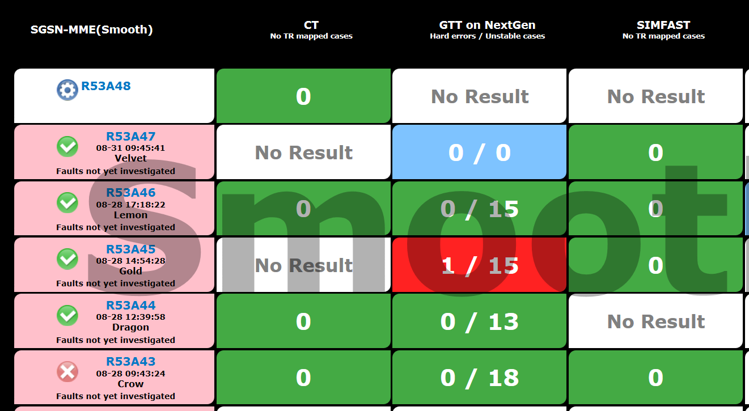
How to interpret the dashboard
Hard fault - Failing 3 out 3 times - No TR ⇒ RED
Unstable faults - Failing 1or 2 out 3 times - No TR
GREEN = No hard fault and unstable faults < 30
RED = At least one new hard fault and/or number unstable faults >30
No new hard fault and unstable faults < 30 ⇒ GREEN

Slide 5
Team responsibility – Before delivery
For all teams:
Check the history of TCs that are unstable on your LLV.
New instabilities should be fixed prior to delivery.
For application teams:
Run exmachina lite before delivery
Run full regression only if needed
For platform teams:
Run platform scope before delivery
Run full scope if needed (team decides) before delivery

Slide 6
Team responsibility for GTT – after delivery
For LSV: Follow up faults on LSV i.e. hard faults and instabilities caused by your delivery, and then after rebase to LSV NS, also follow up the result there. Note that TSARs may submit TRs for your test cases and assign them to you if they are frequently unstable.
For LSV NS: Follow up on LSV NS only
NOTE: Faults that are TR-mapped are excluded from the dashboard
NOTE: unless the result is “0/0” the Teams still need to check the result

Slide 7
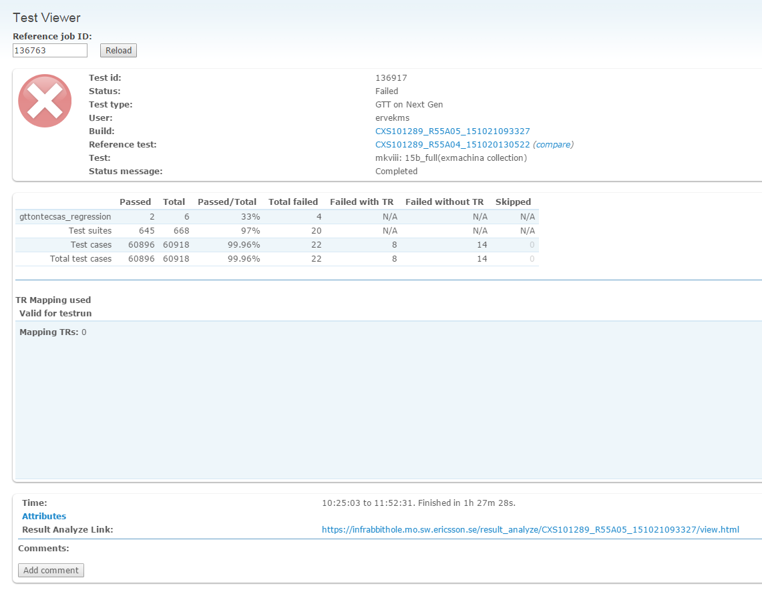
Team responsibility for GTT – after delivery
For LSV: Follow up faults on LSV i.e. hard faults and instabilities caused by your delivery, and then after rebase to LSV NS, also follow up the result there. Note that TSARs may submit TRs for your test cases and assign them to you if they are frequently unstable.
For LSV NS: Follow up on LSV NS only
How to find failing TCs related to the delivery (*)
(*)Applicable for Erlang code

Slide 8
Team responsibility for GTT – after delivery
For LSV: Follow up faults on LSV i.e. hard faults and instabilities caused by your delivery, and then after rebase to LSV NS, also follow up the result there. Note that TSARs may submit TRs for your test cases and assign them to you if they are frequently unstable.
For LSV NS: Follow up on LSV NS only
Failed TCs related to the delivery (*)
(*)Applicable for Erlang code

Slide 9
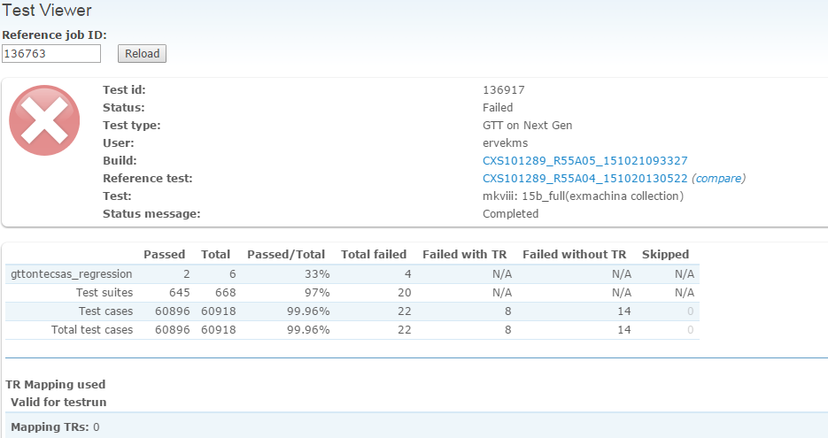
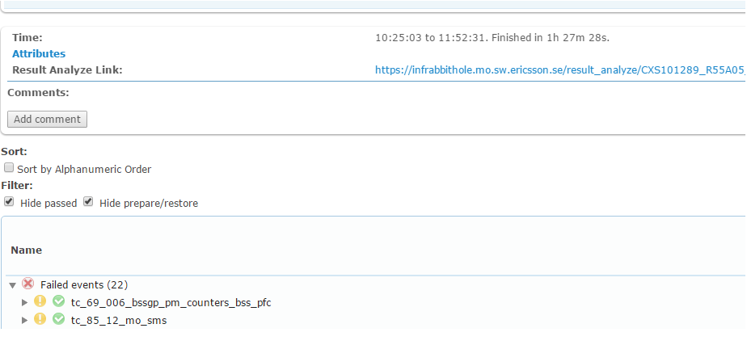
Team responsibility for GTT – after delivery
Make a comment to show that you are investigating

Slide 10
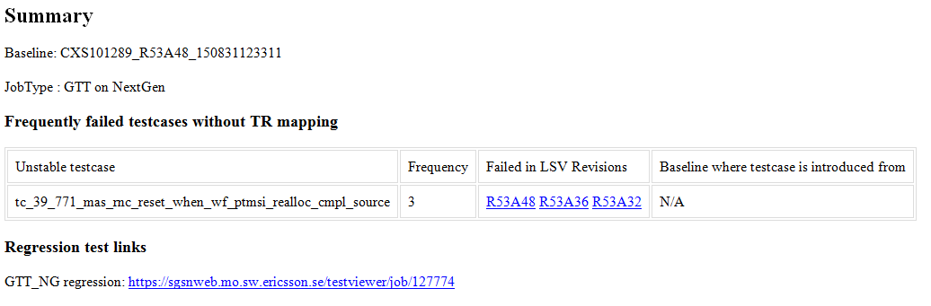
Frequently Failing GTT TC emails
All TSARs are automatically notified via email when a TC in one of their TS has failed more than 3 times over the last 30 regressions
This is the signal that a TR should be submitted
NOTE: The limit of 30 build will be increased later (target = 50) when we see a decrease in the inflow

Slide 11
TR mapping responsibilities
TC failing 3 out of 3 times (hard fault) after one delivery.
For these faults it is always the delivering XFT that is responsible for submitting and for starting to resolve the TR. This applies both to new TC and for legacy TC.
TC failing 1 or 2 times out of 3 (unstable) after one delivery
If the TC is related to the specific delivery, then it is the responsibility of the delivering XFT to submit and start to resolve the TR.
Frequently failing (unstable) test cases:
The basic rule is that the TSAR should submit a TR (within 24 hours) when he/she receives an email notification about a frequently failing GTT TC in a TS. The TSAR should of course control that there is no TR already for the specific TC.
In case this does not happen (e.g. due to sickness, vacation, too high work load etc. of the TSAR ) then the Tiger team may submit a TR and if so they shall notify the TSAR.

Slide 12
TR assignment due to frequently failing TC
The TSAR should always attempt to track the unstable behavior to an XFT delivery and assign the TR to that team
New or modified test cases should be possible to associate with an XFT delivery as this should be visible in test case history.
For legacy TC that has become frequently unstable it is usually not obvious what has caused a TC to become unstable (see appendix for guidance).
It is the responsibility of the TSAR to make sure that something happens with these TRs.
The Tiger Team may however ask the TSAR to take over the responsibility in case e.g. a more general fault has been observed, or the fault is critical and must be corrected asap, or if the Tiger team has already identified the related XFT delivery.
The TSAR may of course contact the Tiger Team for help.

Slide 13
TSAR tr HANDLING for frequently failing TC
The TSAR’s analysis of a TR for a frequently failing TC may result in the following actions:
Fault assumed to be related to GTT FW ⇒ Contact the GTT team and forward the TR to them.
The TC can be associated with an XFT delivery ⇒ Contact the XFT
The TC is nonfunctional and the TSAR has the time to correct it ⇒ The TSAR resolves the TR.
None of the above is true ⇒ Leave the TR in submitted until either the TSAR has more time or someone else can take it (e.g. TR-team), but follow up if the TC continues to fail and close the TR if the fault has not been observed for another 50 builds.
Escalate to DO, TSAR-forum if TR-levels increase radically in a TS to get help.

Slide 14
What happens when quality deteriorates?
Case: Total GTT_LSV TR-level & sub-system specific TR-levels below target Action: TSARs and teams handles GTT_LSV TRs
Case: Sub-system specific GTT_LSV TR-levels too high Action: Flag to DO/TSAR forum. Sub-system DO and or FT DO Escalate to PO for help
Case: Total GTT_LSV TR-levels too high Action: FT DO escalates to PO for help
Case: GTT_LSV fault trend is too high Action: Tiger team and/or FT DO escalates to PO
PO should take action at escalation e.g. assign a dedicated resource in a TR-team for a sprint, a full TR-team for a sprint or assign a number of frequently failing TRs to multiple teams

Slide 16
APPENDIX: TSAR and Tiger Team WoW with unstable GTT TC
TC failing 3 out of 3 times (hard fault) after one delivery.
For these faults it is always the delivering XFT that is responsible for submitting and for starting to resolve the TR. This applies both to new TC and for legacy TC. In case multiple teams delivers at the same time and it cannot be determined who caused a TC to fail, then the delivering teams needs to resolve this together and make sure that one of the teams submits a TR for the fault and starts to resolve it.
TR mapping of frequently failing (unstable) test cases:
The basic rule is that the TSAR should submit a TR (within 24 hours) when he/she receives an email notification about a frequently failing GTT TC in a TS. The TSAR should of course control that there is no TR already for the specific TC.
Motivation: Reduce load on tiger team
It is also good that the TSAR is aware of the TR situation in the TS.
In case this does not happen (e.g. due to sickness, vacation, too high work load etc. of the TSAR ) then the tiger team will submit a TR and notify the TSAR.
Tiger team may use the frequently failing GTT TC notification email to determine this i.e. number of failures for a TC is more than 3 (since TSAR should react when it is 3 this makes sense).

Slide 17
APPENDIX: TSAR and Tiger Team WoW with unstable GTT TC
Follow up with XFT and assignment of TR due to frequently failing GTT TC
NOTE: For this situation it is the TSAR that drives the correction of specific TCs
The TSAR should attempt to track the unstable behavior to an XFT delivery (not always so easy of course). Some options:
New or modified test cases should be possible to associate with an XFT delivery as this should be visible in test case history.
For legacy TC that has become frequently unstable it is usually not obvious what has caused a TC to become unstable. In most cases an analysis of GTT-logs in the portal is needed. Unless the Tiger Team has said otherwise, it is the responsibility of the TSAR to make sure that something happens with these TRs. The Tiger Team may however ask the TSAR to take over the responsibility in case the following has happened:
A more general fault has been observed that affect multiple TC.
The Tiger Team believes that the fault is critical and must be corrected asap (best effort is not good enough).
The Tiger Team successfully identified the XFT that caused the problem. In this case the Tiger Team assigns the TR to that specific XFT.
The TSAR may of course contact the Tiger Team for help.

